Slide 1
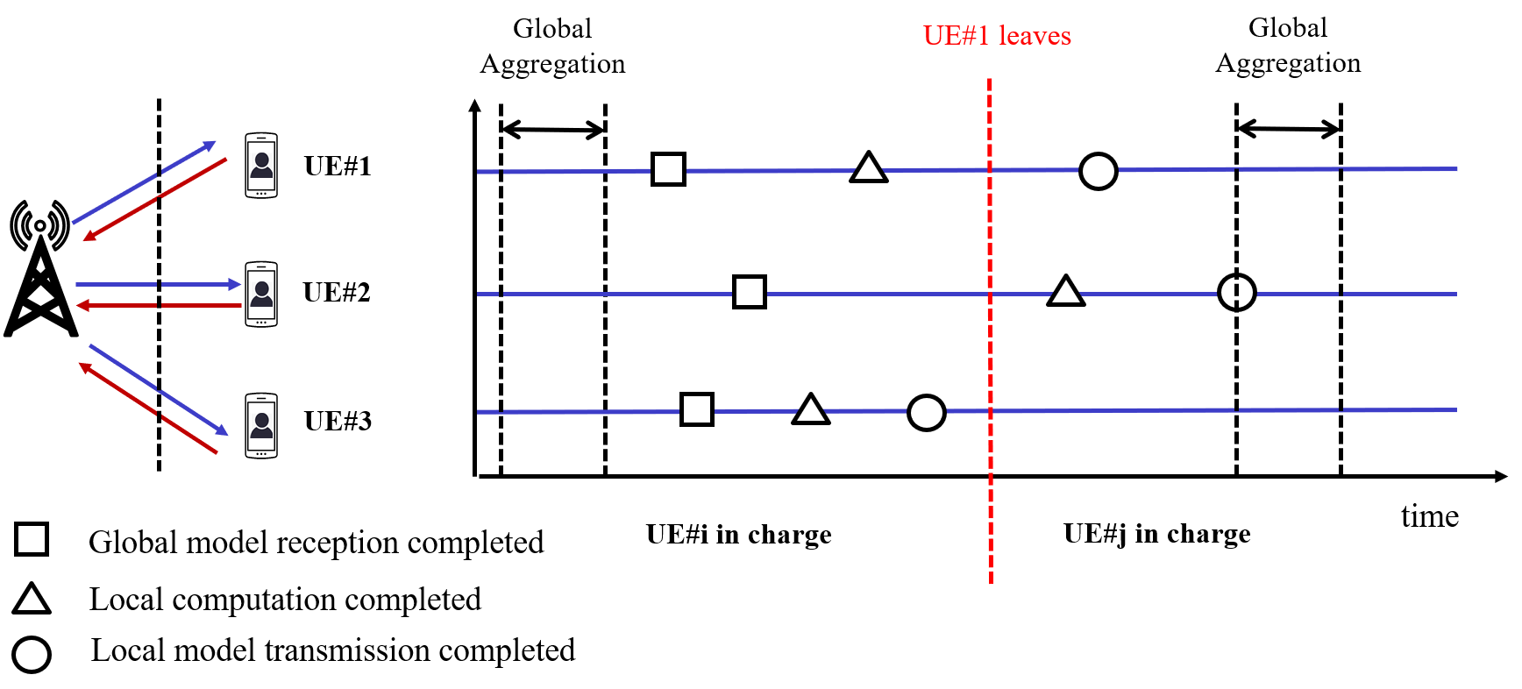

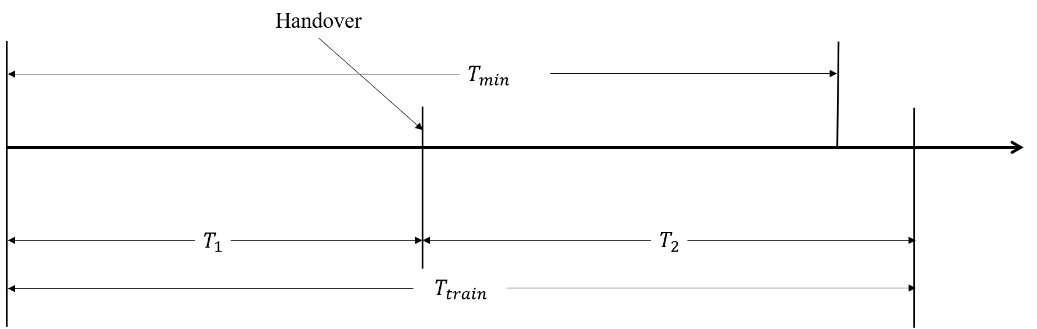
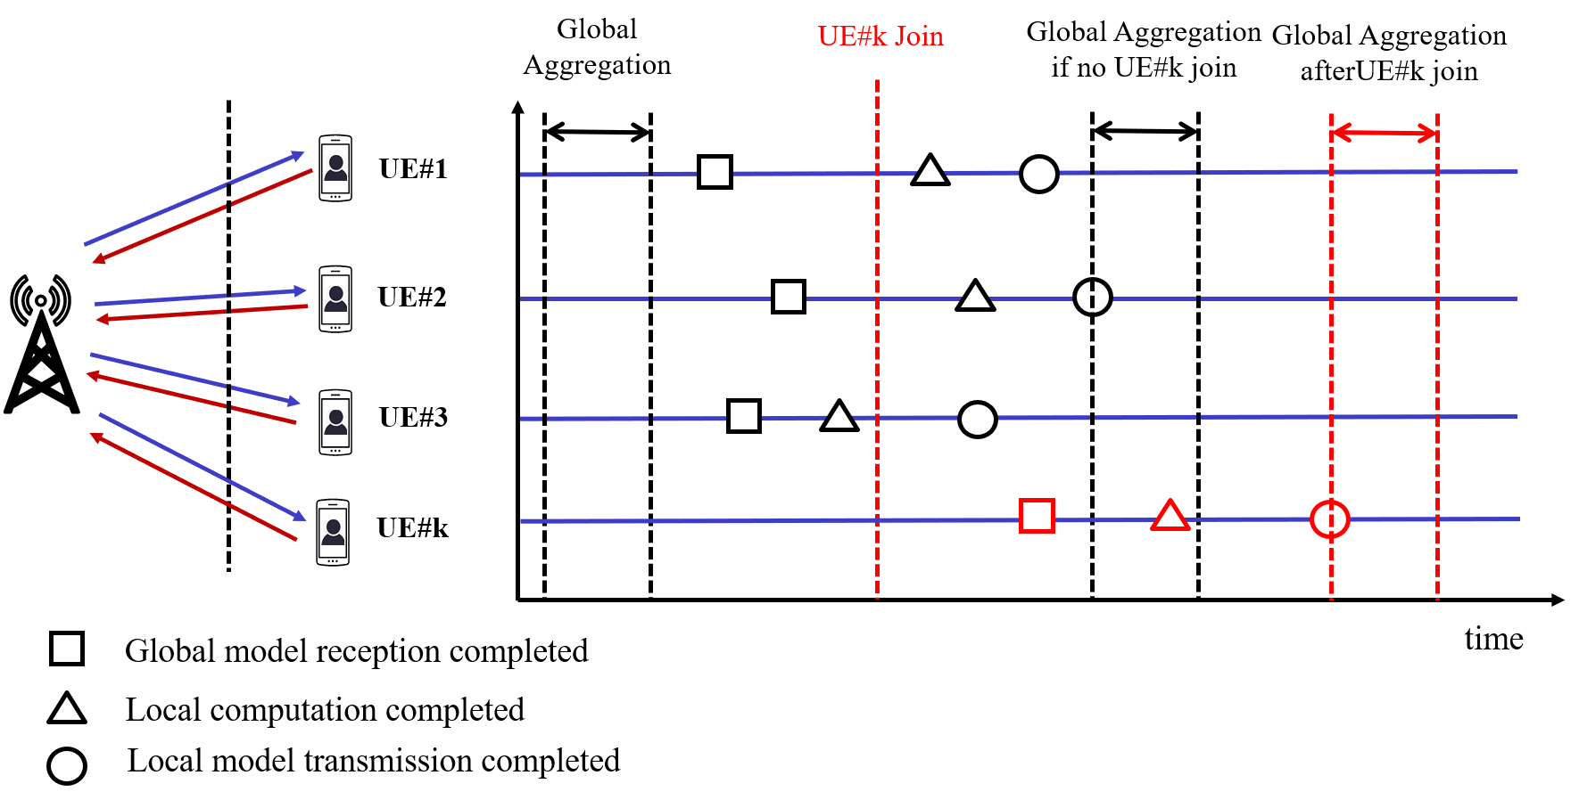
A service guarantee strategy in Federated Learning (FL) Network
Scenario & : Problems
3. UEs leave the FL process
Aggregator changes from UE#i to UE#j:
1. The aggregator changes during the training process:
T₁ --- from now to global aggregation finished in this round
T₂ --- from now to global aggregation finished in next round
T_{min} --- the left time that UE#i could still serve
UE#1 leaves: it has finished its model updates, and gNB already allocates the radio resources. This leads to the waste of computation and communication resources.
Aggregator changes from Node#i to Node#j: UE#3 has uploaded its model to Node#i; UE#2 will upload its model to Node#j; UE#1 is in the uploading process.
We can handover in advance.
2. New UEs join the FL process
Solution:
Standard impact:
Because UEs and aggregator share the same model after global aggregation.
Handover and new UE joining must happen at the time point when global aggregation is just done;
The leave of UE must happen after uploading its local model
We can increase transmit power or lower the transmit rate (e.g. threshold of SINR, RSRP, etc)
Or
Take action in advance:
TR23.700-80: Study on 5G System Support for AI/ML-based Services
TS 22.261: Service requirements for the 5G system
WID “Study on AI/ML Model Transfer Phase 2” SP-220439 “Distributed AI training/inference based on direct device connection”.
UE#k join in the middle of process, the gNB has to transmit global model to UE#k (as opposed to broadcasting); all UEs have to wait

